Slide 1



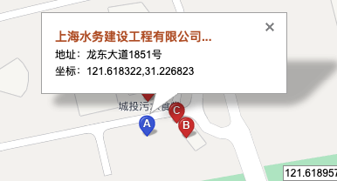
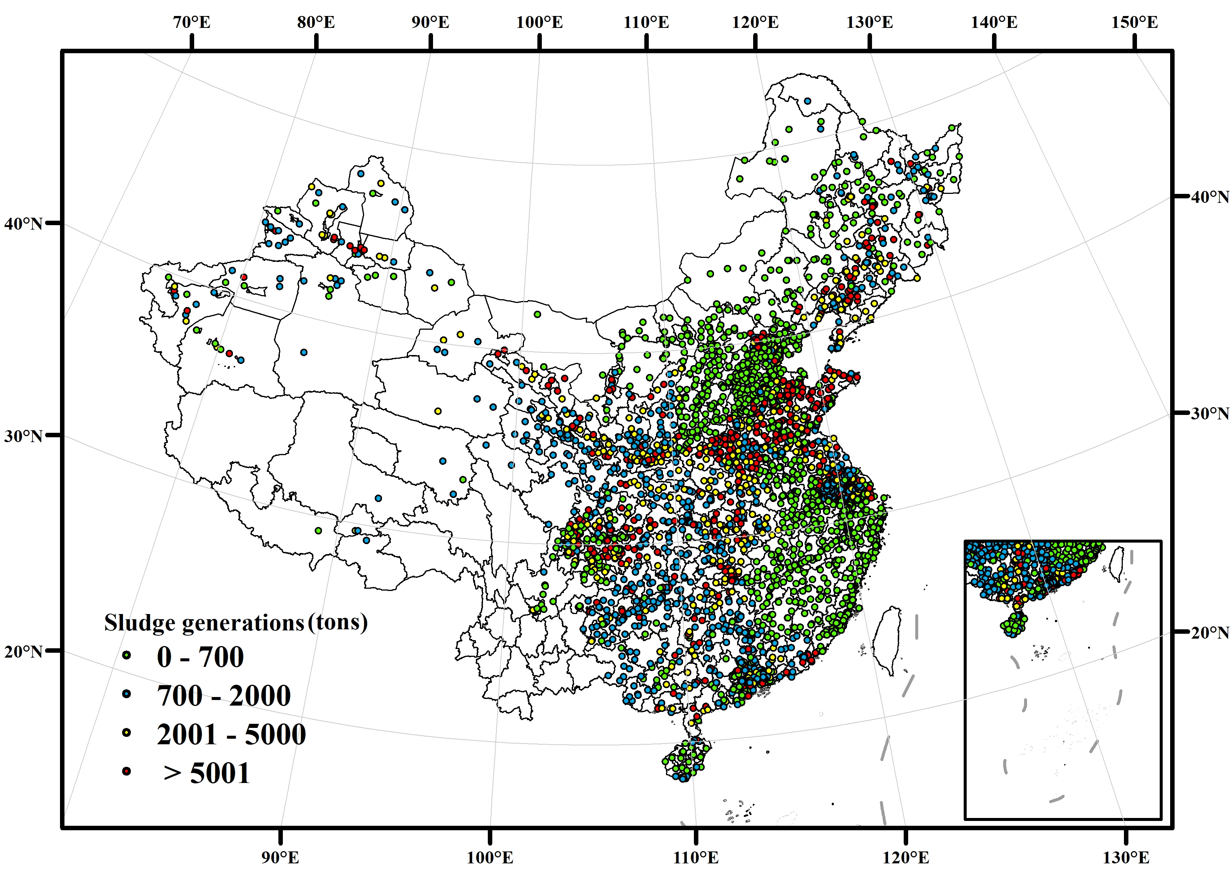
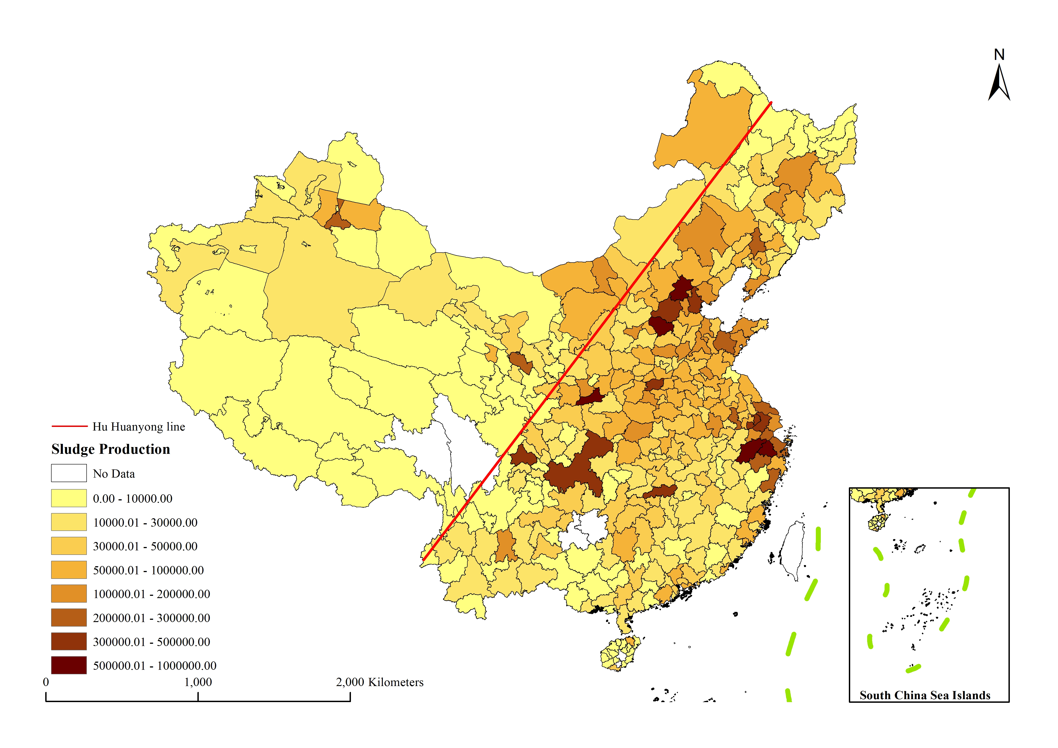
Address:
No. 1851, Longdong Avenue, Shanghai, China
Bailonggang Wastewater treatment plant
Calculation:
Collecting sludge data of each WWTPs. Filling the missing values by the flows of wastewater treatments.
Comparison:
Compare the sludge data we’ve calculated with Yearbooks.
Coordinate:
121.618322N, 31.226823E (BD09: Baidu Map)
Aggregating:
Aggregating all the sludge data at city level.
Correction:
Correcting data that has an obvious bias.
Plants Address
Sludge Data
Data Validation

Slide 2
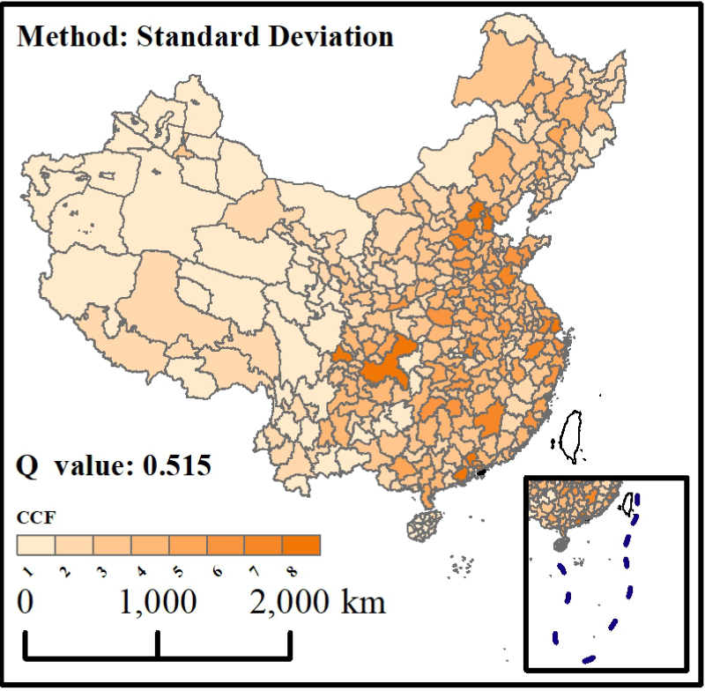
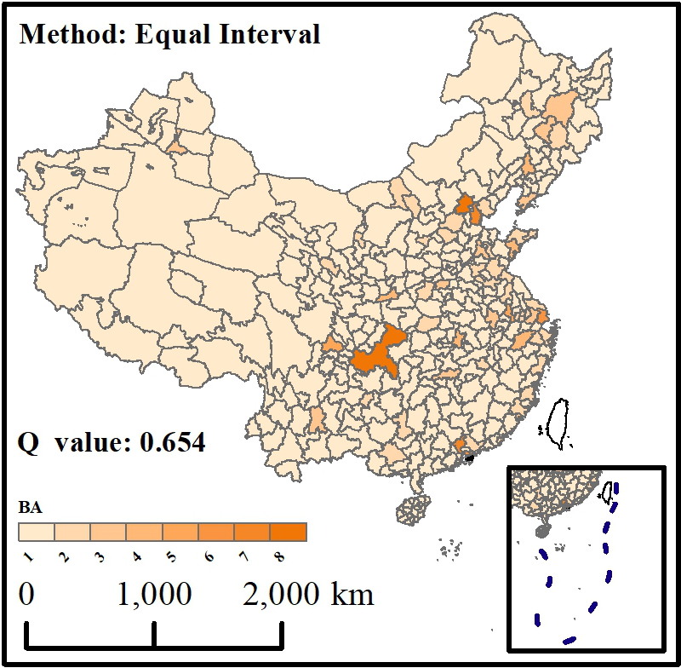
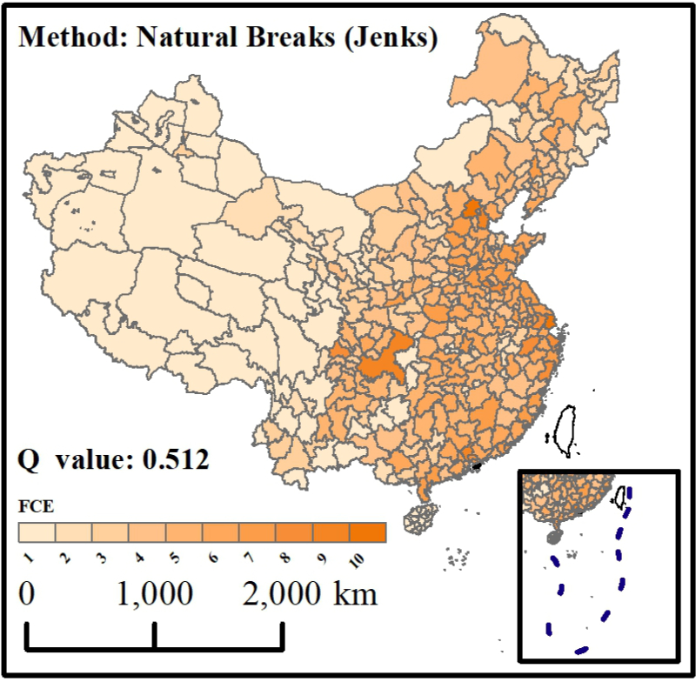
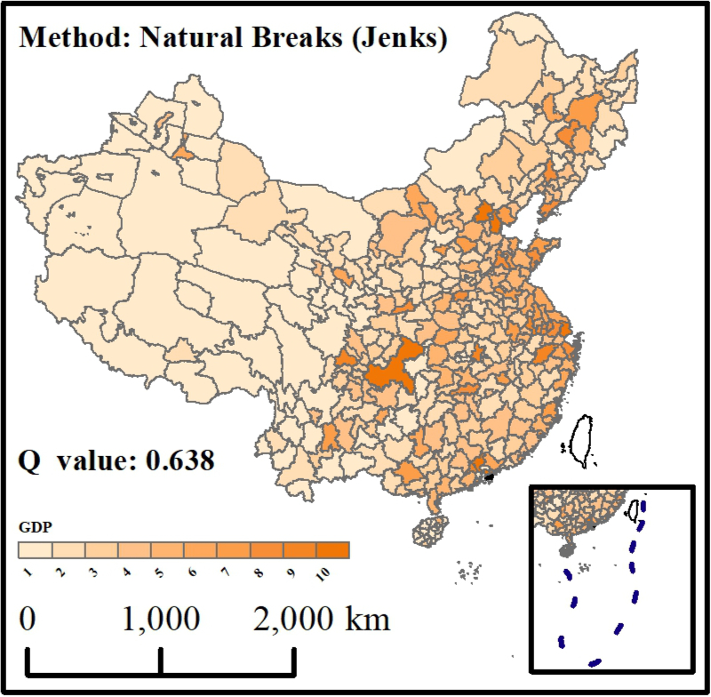
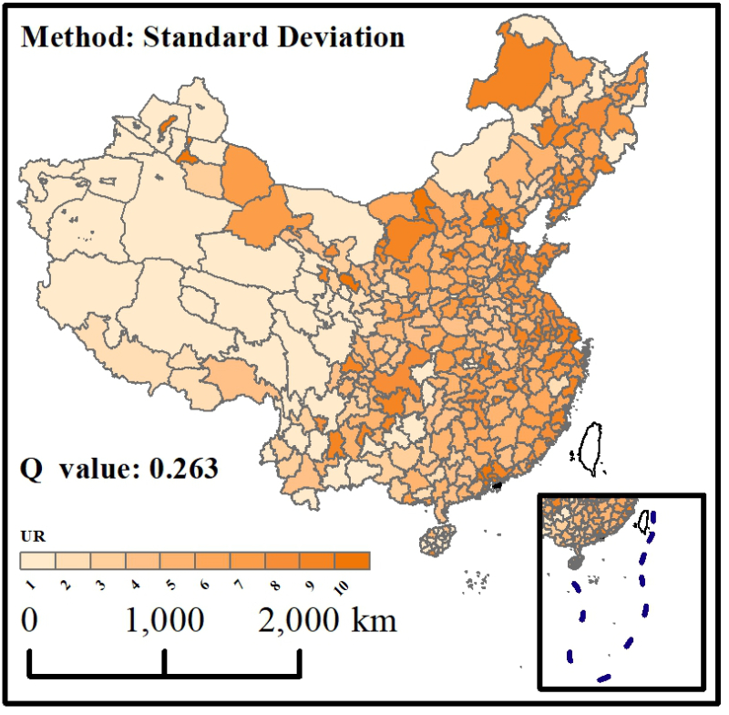
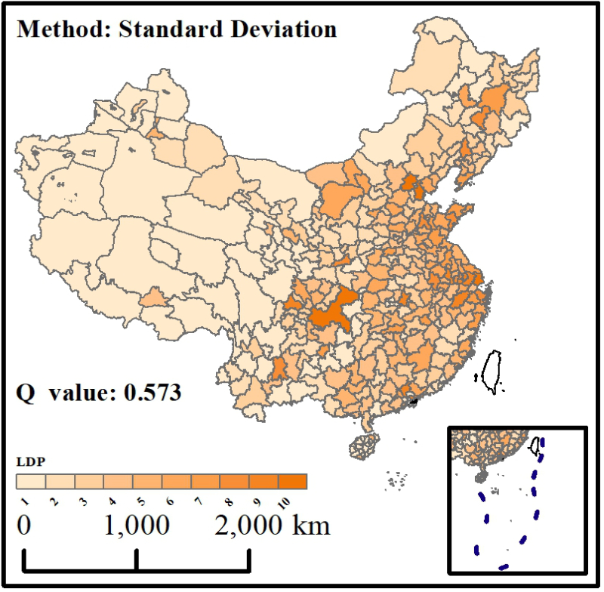
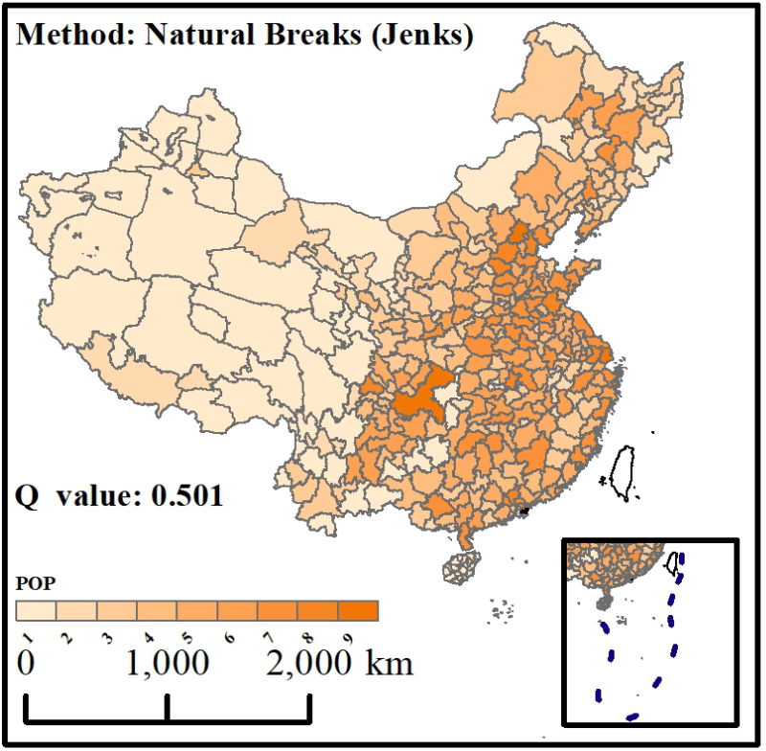
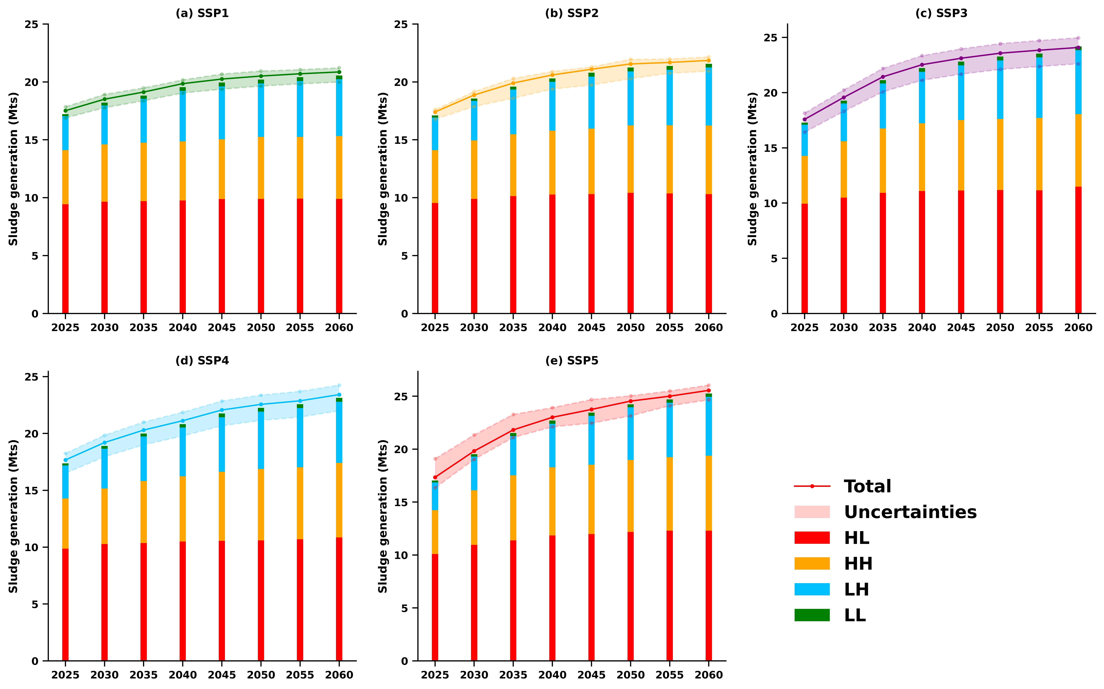
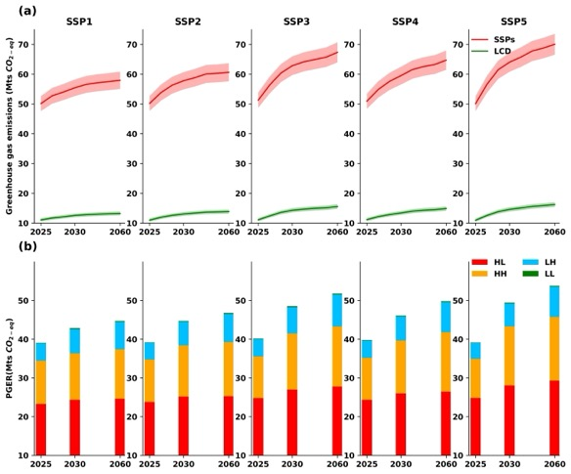
Sludge Generation
Driving Factors
GeoDetector
Machine Learning
SSPs Scenarios
Future Trends

